Slide 1
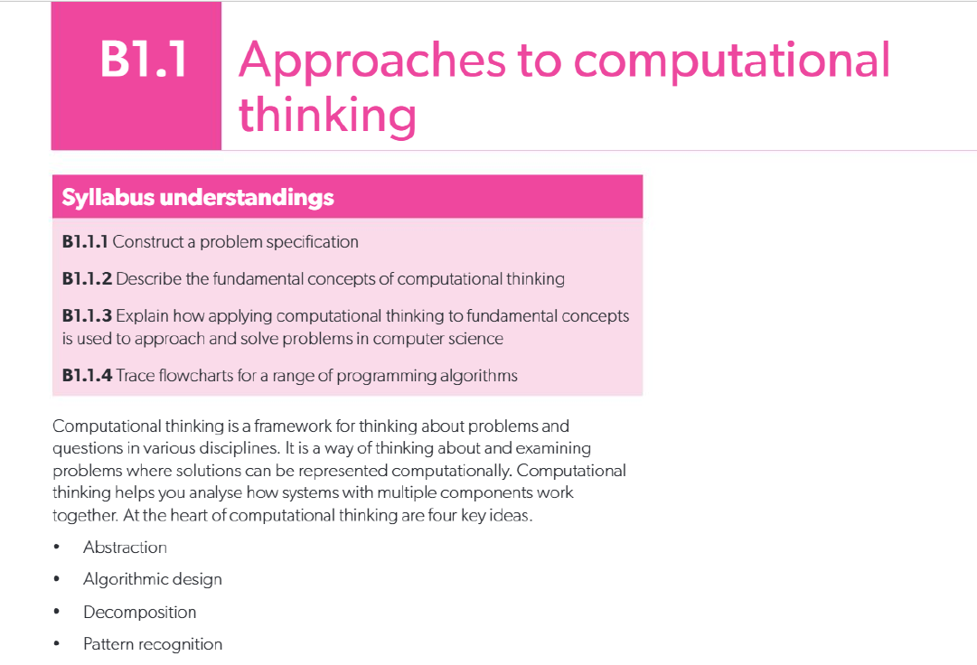

Slide 2
STARTER
🧠 Starter: Computational Thinking Brainstorm (5 mins)
Task: Think about this real-life situation:
👉 You want to design a mobile app that helps students order food from the school canteen without standing in line.
Using the four key ideas of computational thinking, jot down quick notes:
Abstraction – What important details matter? (Ignore things that don’t.)
Decomposition – What smaller tasks or parts make up the whole system?
Pattern Recognition – What similarities can you find with other apps (like food delivery apps, or online shopping)?
Algorithmic Design – What would be the step-by-step process a student follows to order food?

Slide 3
Constructing a Problem Specification
A problem specification includes:
Problem Statement – Clearly define the problem.
Constraints & Limitations – Identify boundaries and restrictions.
Objectives & Goals – State what needs to be achieved.
Input Specifications – What goes into the system.
Output Specifications – What comes out of the system.
Evaluation Criteria – How success will be measured.

Slide 4
The Problem Statement
Must be clear, concise, and specific.
Focus on the “what” and “why” of the problem.
Avoid ambiguity.
Can come from a client or be self-identified (e.g., for IA).
Defines the foundation before moving to solutions.

Slide 5
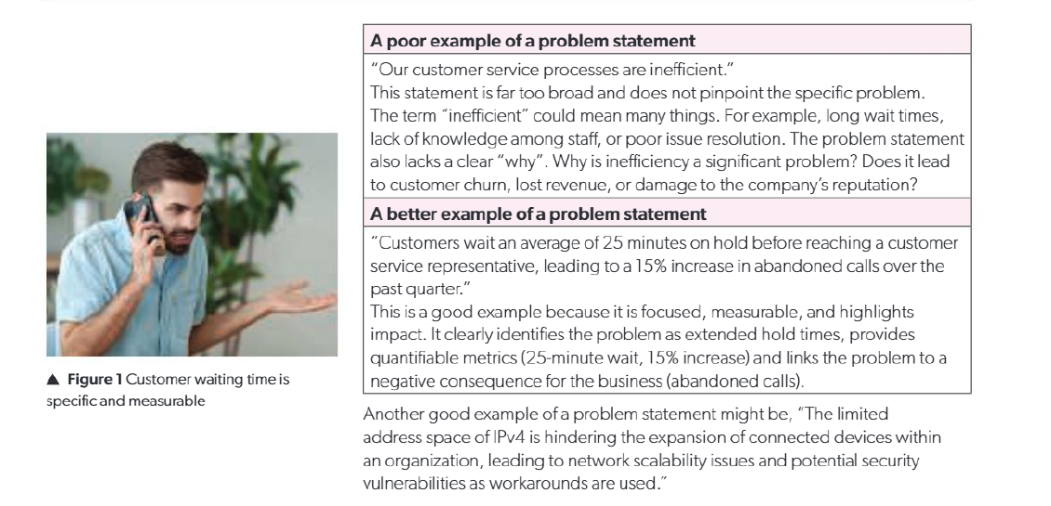

Slide 6
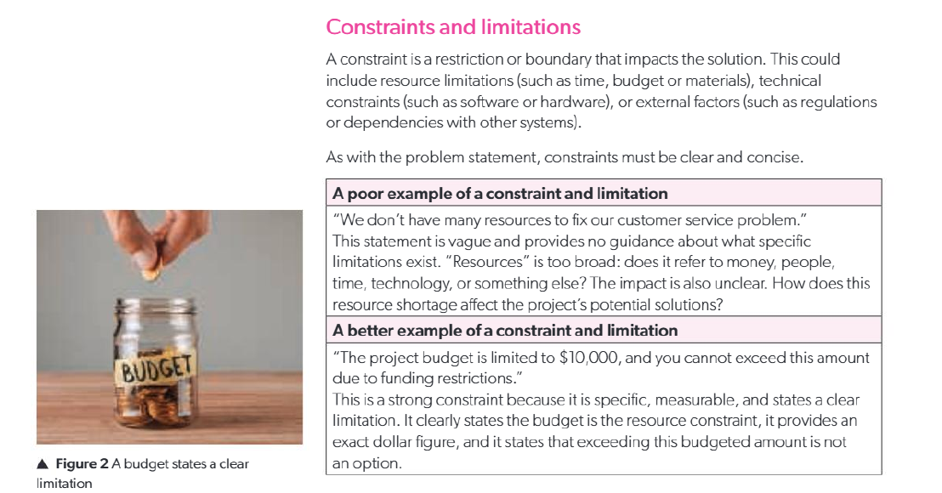

Slide 7
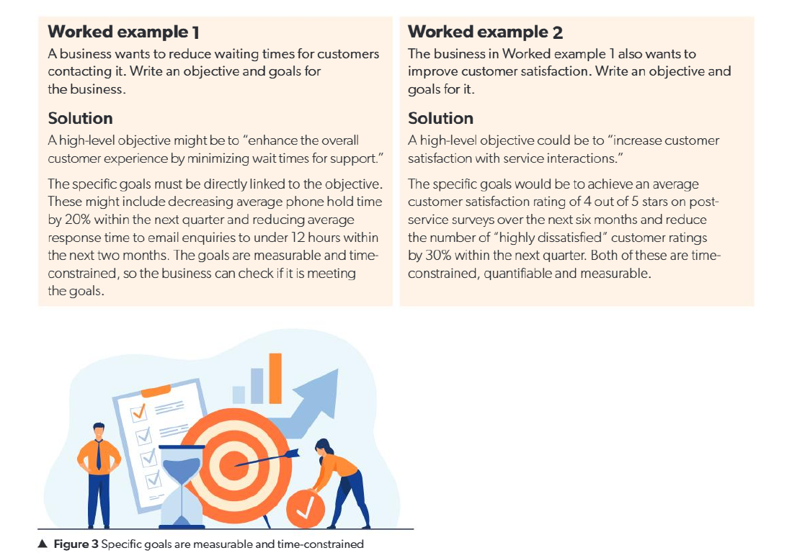
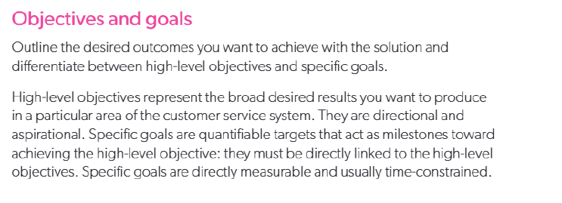

Slide 8
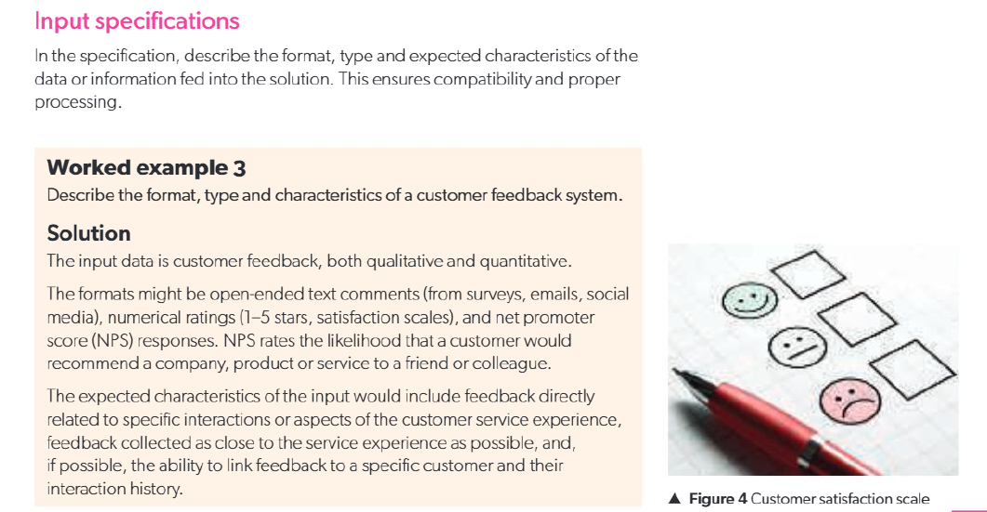

Slide 9
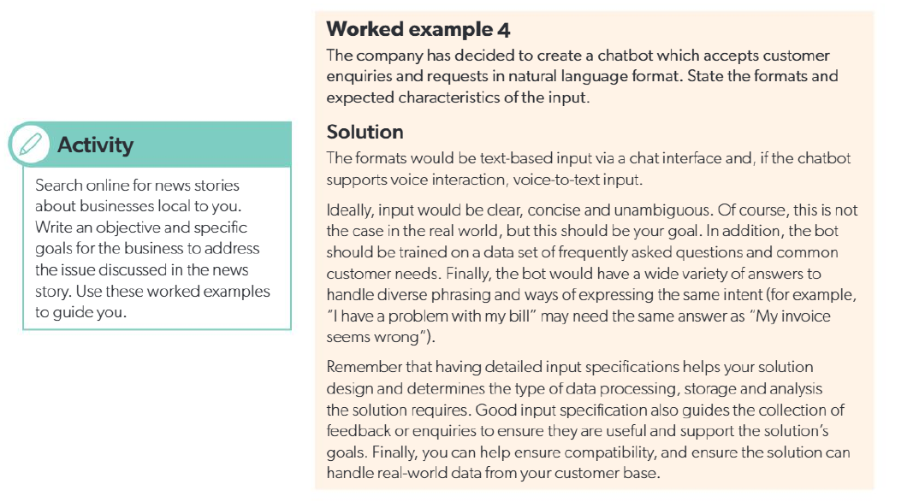

Slide 10
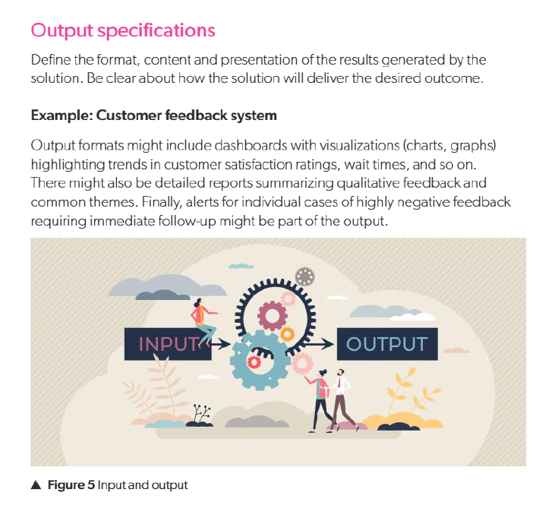
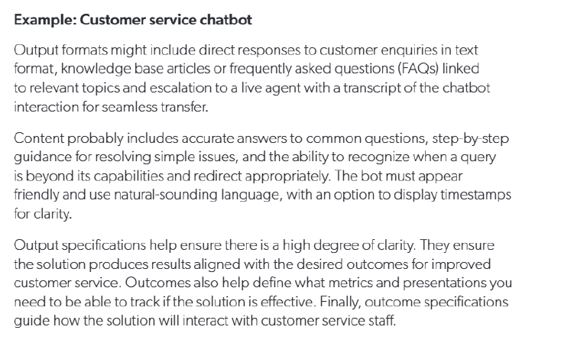

Slide 11
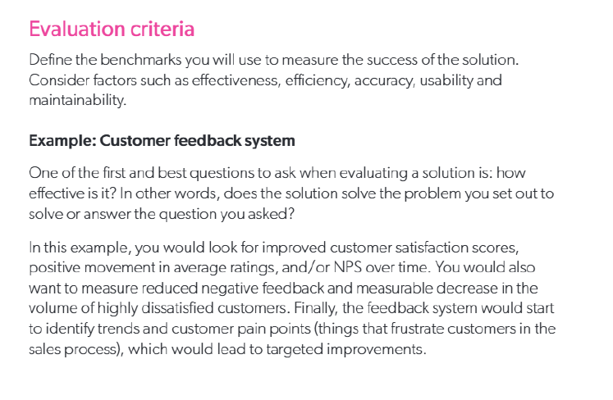

Slide 12
How can we apply a computational solution to a real-world problem? [6 marks]
Exam-style questions
2. Describe what a problem statement is and why it is critical in the problem
specification process. [2 marks]
3. Explain the difference between a poor and a strong problem statement,
giving examples of each. [4 marks]
4. a. Define the role of constraints and limitations in a problem
specification. [1 mark]
b. Outline an example of a well-defined constraint. [2 marks]
5. a. Define:
i. high-level objectives
ii. specific goals. [2 marks]
b. Compare high-level objectives and specific goals in the context of
computational problem-solving. [3 marks]
6. Discuss The role of input and output specifications in ensuring the effectiveness
ofa computational solution. [3 marks]

Slide 13
7. a. Describe the process of decomposition in computational thinking. [2 marks]
b. Explain how decomposition can be applied to solve a
real-life problem. [2 marks]
8. a. Describe the concept of pattern recognition. [2 marks]
b. Explain the importance of pattern recognition in computational
thinking, using a relevant example. [2 marks]
9. a. Describe how abstraction simplifies problem-solving in
computational thinking. [2 marks]
b. Explain how abstraction can be applied to solve a
real-life problem. [2 marks]
10. Describe the process of algorithmic design, including the steps
typically followed in creating an algorithm. [4 marks]
11. Explain how the four fundamental concepts of computational thinking
(abstraction, algorithmic design, decomposition and pattern recognition)
work together to solve problems in computer science. [4 marks]

